Slide 1
Pollution and Global Warming

Slide 2
Key Points:
Pollution occurs when humans add a substance to the environment that affects organisms at a rate faster than what can be rendered harmless.
Pollution from point sources is often easier to manage than that from non-point sources.
Types of pollutant include gases from burning fossil fuels and industry, solid and liquid waste from industry, agriculture and homes.
Examples of pollution are eutrophication; solid domestic waste; depletion of stratospheric ozone; urban air pollution; and acid deposition.

Slide 3
Key Points:
Pollution management of these issues can be considered in the replace, regulate, and restore, model. But factors such as culture, politics and economics influence strategies used to manage pollution.

Slide 4
What is pollution?
Two definitions:
The addition to the biosphere of a substance or an agent (such as heat) by human activity, at a rate greater than that at which it can be rendered harmless by the environment, and which has an appreciable effect on the health of organisms within it.
A substance in the biosphere at the wrong place, in the wrong amount, or at the wrong time.

Slide 5
Examples of pollutants
Can be matter: gases, liquids or solids
Can be energy: noise, light, or heat
Sewage and waste are products of human communities and burning wood and then coal has caused air pollution for 1000 years. It might be an inevitable side-effect of economic development—meaning we have to choose between a higher standard of living and more pollution or less pollution and more discomfort.

Slide 6
Sources of pollutants
Main sources of pollutants:
Combustion of fossil fuels
Domestic waste
Industrial waste
Agricultural waste

Slide 7
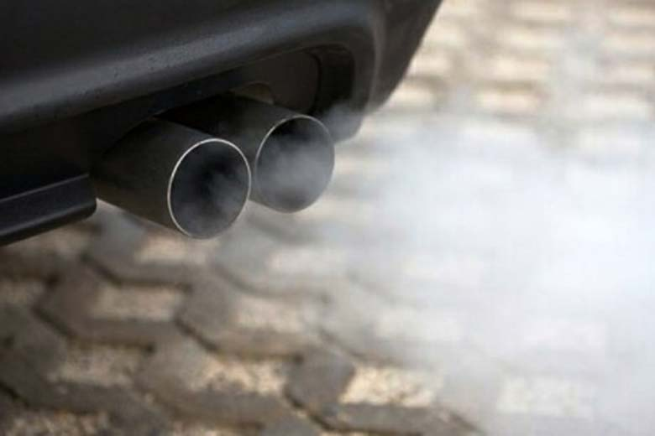
Sources of pollutants

Slide 8
Sources of pollutants
Combustion of fossil fuels: produces Carbon dioxide which is a greenhouse gas; Sulfur dioxide which causes acid rain; Nitrogen oxide which causes smog; Photochemical smog (more on this later); Carbon monoxide which causes death.

Slide 9
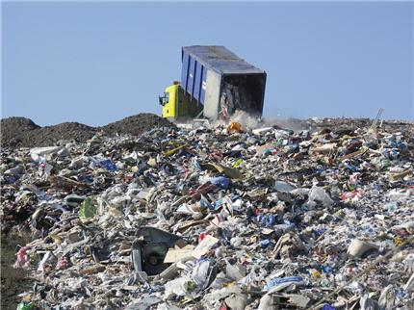
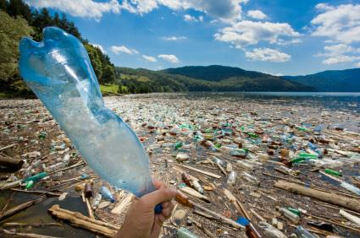
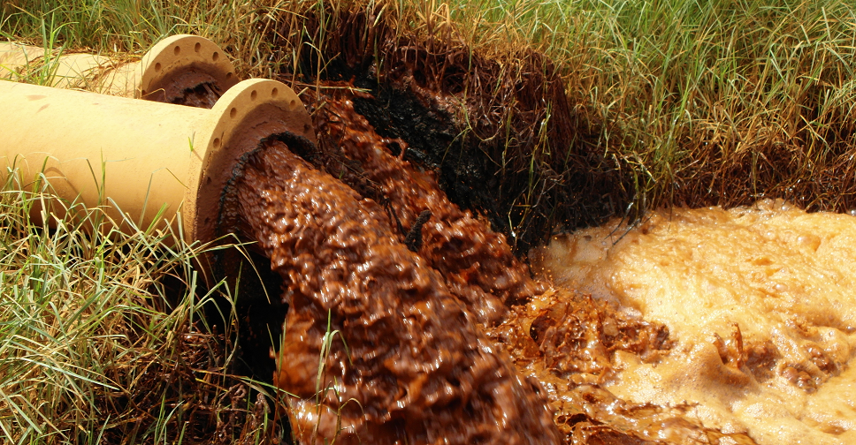
Sources of pollutants

Slide 10
Sources of pollutants
Domestic waste: Organic waste (food and sewage) which can cause eutrophication (more later) and water borne diseases; Waste paper which fills up landfills and adds to demand for timber; Plastics (especially containers and packaging) which fills up landfills and is derived from oil (also creating the Great Pacific Garbage Patch (more later); Glass which fills landfill and requires fair amount of energy to replace; Tins, which fill landfills and use contribute to mining of ores.

Slide 11
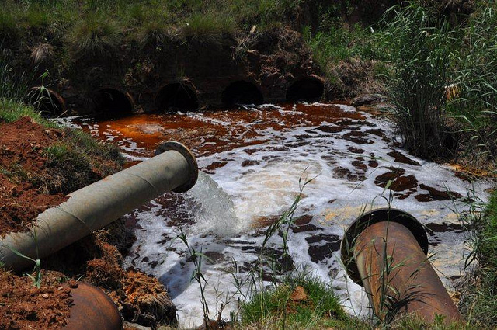
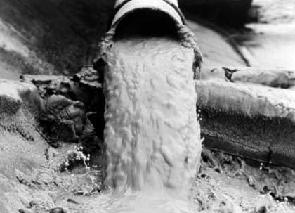
Sources of pollutants

Slide 12
Sources of pollutants
Industrial waste: Heavy metals like mercury, lead and cadmium (no AC/DC), cause poisoning—think Minimata Bay; Fluorides poison our water (yup, same stuff on our teeth—remember quality of life); Heat reduces the solubility of gases (like oxygen) in water—no big deal unless you are a fish or a plant that relies on those gases; Acids which corrode and (because they are an abiotic factor) re-determine what lives where.

Slide 13
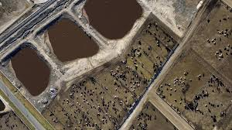
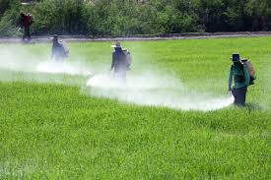
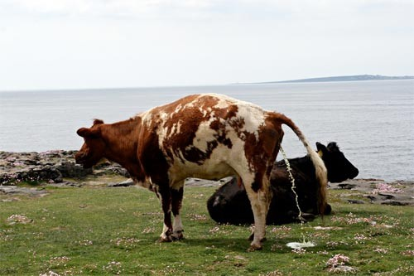
Sources of pollutants

Slide 14
Sources of pollutants
Agricultural waste: Nitrates, which cause eutrophication; phosphates, which causes eutrophication; organic waste which cause disease and usually contain nitrates and phosphates; Pesticides magnify up the food chain.

Slide 15
Point Source and Non-point Source Pollution
Point Source: the release of pollutants from a single, clearly identifiable site (factory chimney or the waste disposal pipe of a sewage works into a river). This form of pollution is easier to manage because it can be identified easier.
Non-point Source: the release of pollutants from numerous, widely dispersed origins (gases from the tailpipes of cars, chemicals spread on farms). It may be virtually impossible to detect exactly where it is coming from. Some chemicals can go underground and travel for miles before detection (Air pollution moves too).

Slide 16
How to detect and monitor pollution
There are two ways to detect pollution: direct and indirect.
Direct: record the amount of a pollutant in water, air or soil. The amount of a gas (CO₂, Carbon monoxide, and nitrogen oxides) are measured. The acidity of rainwater can be measured and related to sulfur in the air. Testing for nitrates or phosphates in water as well as the amount of bacteria in the water or soil. Measuring the soil for heavy metals is another example.

Slide 17
How to detect and monitor pollution
Indirect measurements: record changes in an abiotic or biotic factor which are the result of the pollutants.
Examples of indirect measurements include measuring abiotic factors that change as a result of the pollutant, like oxygen content of water and the presence or absence of indicator species (species which are only found if the conditions are either polluted—rat-tailed maggot, or unpolluted—leafy lichens on trees.

Slide 18
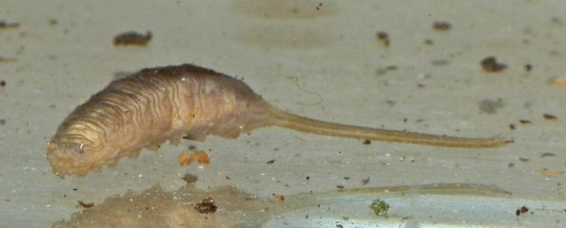
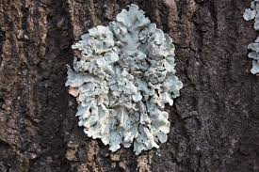
How to detect and monitor pollution

Slide 19
Biological Oxygen Demand
The biochemical oxygen demand or BOD is a measure of the amount of dissolved oxygen required to break down the organic material in a given volume of water through aerobic biological activity (by micro-organisms).
By measuring the BOD of effluent from a sewage treatment facility or farm lagoon, monitors can indirectly measure the amount of an organic pollutant is present. The more bacteria, the greater the pollutant present.
Unpolluted river = <5 mg D.O., Cattle slurry = 10,000

Slide 20
Biotic indices and indicator species
An indicator species is a species that show something about the environment by their presence or absence. They are the canary in the mine.
A biotic index is a scale (1-10) that gives a measure of the quality of an ecosystem by the presence and abundance of the species living in it.
These are indirect measurements of pollution and are often used at the same time as BOD.
BOD gives you a measurement at the instant the sample is taken, where indicator species give you a summary.

Slide 21
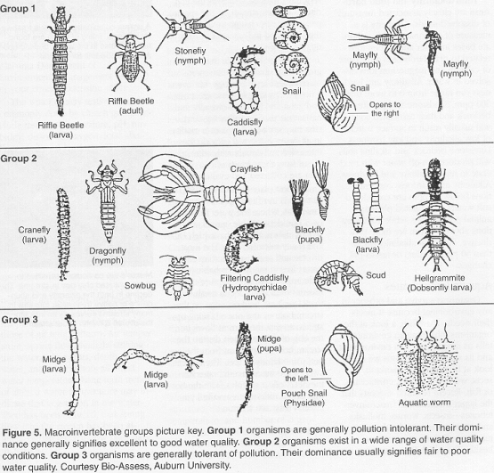
Biotic indices and indicator species

Slide 22
The three level model of pollution management
Replace, Regulate and Restore.
Replace: This means to replace the polluting behavior with proper management—essentially to stop producing and dispose of it properly. Of course, this is difficult if the polluter doesn’t know they are polluting or doesn’t care.
Replacing includes a variety of actions to encourage polluters to stop the undesirable behavior—developing alternate technologies to make disposal possible. And educating the public and polluters on the effects of pollution and the appropriate alternatives.

Slide 23
The three level model of pollution management
Replace, Regulate and Restore.
Regulate: many activities like burning trash in your backyard were commonplace (so was throwing your garbage in the street), the first step in changing that behavior was setting and imposing standards everyone had to follow.
It also includes imposing punishment if the standards are not followed.
Not everyone agrees on the standards (#EPA and Peabody coal).
This would also require educating the public on the new standards.

Slide 24
The three level model of pollution management
Replace, Regulate and Restore.
Restore: Cleaning up the pollutant and restoring the ecosystem by:
Extracting and removing the pollutant from the ecosystem
Replanting and restocking with animal populations.
Can you say Superfund?

Slide 25
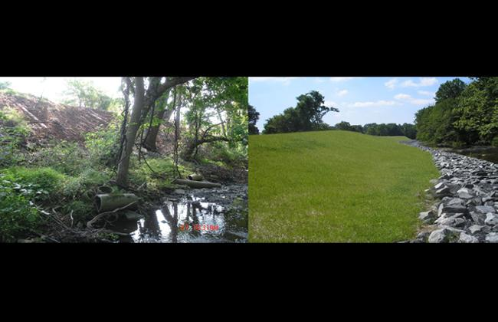
The three level model of pollution management

Slide 26
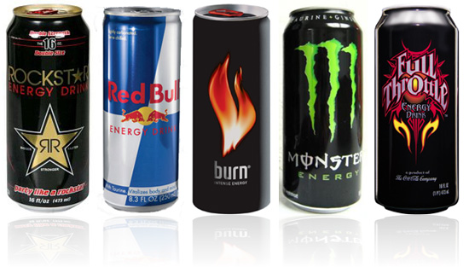
Strategies to reduce domestic waste

Slide 27
Strategies to reduce domestic waste
Waste is material which has no value to its producer. We create waste in most of the processes we carry out (energy production, transport, industrial processes, construction, selling of goods and services, and domestic activities).
On average we produce nearly 6 pounds of waste per person in the U.S.. Since 1985 (about 30 years) the per capita per year amount of waste has risen from 300 kg (660 lbs) to 500 kg (1100 lbs) (Americans generate 2400 lbs/year).

Slide 28
Strategies to reduce domestic waste
Solid domestic waste (SDW) or municipal solid waste (MSW) is our trash, garbage, rubbish. It is a mixture of paper, packaging, organic materials (waste food), glass, dust, metals, plastic, textiles, paint, old batteries. It is collected from homes and shops and, although it only makes up about 5% of total waste, which includes agricultural and industrial waste, it is the waste that we can control.

Slide 29
Strategies to reduce domestic waste
Strategies to minimize waste:
Reduce, reuse, recycle.
The best action we can take is producing less waste in the first place—reducing.
Instead of buying new all of the time, buy used, repurpose and object, barter with someone else, in other words reuse.
Recycling—involves the collection and separation of waste materials and processing them for reuse. If items are separated from the waste stream, washed and reused without processing—this is reuse, not recycling.

Slide 30
Strategies to reduce domestic waste
Recycling:
The economics of recycling determine whether it is commercial or not and this can vary with market cost of the raw materials or cost of recycling. Some materials, such as Alumnium, have a high cost of production from the raw material and so recycling is particularly worthwhile commercially (7 times more worthwhile!). In the U.S. alone 100 billion cans are produced per year. Half of these are not recycled. One recycled aluminum can saves enough energy to run a television for 3 hours.

Slide 31
Strategies to reduce domestic waste
Recycling:
Recycling steel cans only requires 25% of the energy to make a new steel can from iron ore.
Glass bottles and jars can be recycled indefinitely, saving the energy that would be used to process new materials, as well as saving landfill space.
Something that is difficult to recycle (but not impossible) is plastic shopping bags. They take between 200 and 1000 years to break down. Over 500 billion bags are made per year– most of which end up in landfills or the ocean.

Slide 32
Strategies to reduce domestic waste
Disposal of waste:
Landfills
Leachate the problem
Incinerators
Air pollution the problem
Organic waste
Disease the problem

Slide 33
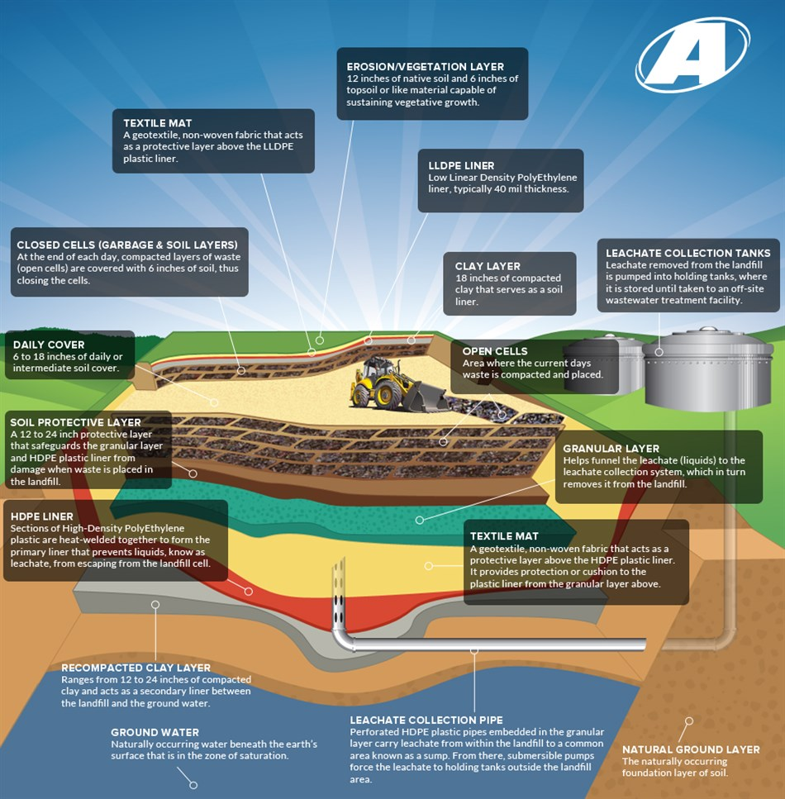
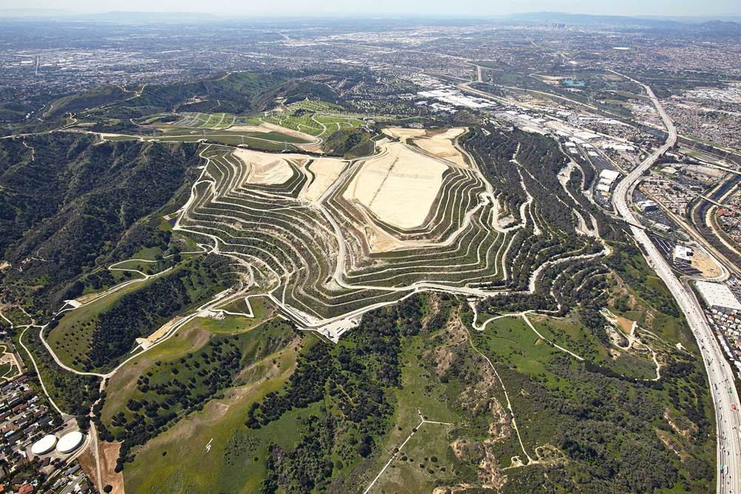
Domestic Waste
Landfills:

Slide 34
Domestic Waste
Landfills:
There are four ways to deal with waste that is not recycled or reused: Dump them in the ocean, compost organic waste, incinerate them, or put them into a landfill.
Landfills are the main form of waste disposal. Sites are carefully selected to limit access to the water table below them, be close (but not too close to areas of high population densities). You can put hazardous waste in them. They are lined with a special plastic liner to prevent leachate (liquid waste) from seeping out. Pipes collect the leachate that forms. Pipes also collect the methane that develops. The whole system is designed to break down trash very slowly because there is none to very little oxygen present which limits how much decomposition can occur. A big problem is we are running out of places to put landfills.

Slide 35
Domestic Waste
Incinerators:
They burn waste at a high temperature (2000 ºC) Sometimes the heat produced is used to generate steam to turn a turbine and generate electricity (this is known as waste-to-energy incineration). The problem with this type of waste disposal is air pollution, particularly the formation of dioxins from burning plastics, heavy metals from burning batteries. The ash from incinerators can be used in road building and the space required for an incinerator is smaller than a landfill by far. The plants are expensive to build (compared to a landfill), and require lots of trash to work efficiently (this tends to promote a throw-away attitude instead of a conservation mindset).

Slide 36
Domestic Waste
Organic Waste:
This is food and sewage. Food can be composted (so can paper and sewage) Or it can be put into anaerobic digesters. The byproduct of anaerobic respiration is methane. This methane can be used as an energy source to burn and turn a turbine for electricity. Any waste left over can be used as a fertilizer and soil conditioner.

Slide 37
Eutrophication
It is the addition of excess nutrients (usually nitrates or phosphates) to a freshwater ecosystem. The high levels of nutrients allow algae to grow faster. The rapid growth of algae forms thick mats (bloom) that block the light from the plants below them, which die. The algae die and are decomposed by aerobic bacteria, but there is not enough oxygen in the water so soon everything dies as the food chain collapses. Oxygen levels fall lower. Dead organic material forms sediments on the lake bed and turbidity increases. Eventually all life is gone and the sediment settles to leave a clear blue—lifeless—lake.

Slide 38
Eutrophication
In lakes or slow moving water bodies, eutrophication leads to a series of damaging changes, which severly reduces biodiversity. In fast moving water, eutrophication leads to a temporary reduction in biodiversity downstream which can be followed by recovery and restoration of clean water.
The excess nutrients usually come from detergents, fertilizers, drainage from intensive livestock rearing units, sewage, and increased erosion of top soil.

Slide 39
Eutrophication
How to manage eutrophication: The three step model:
Replace—Ban or limit detergents containing phosphates. Plant buffer zones between fields and watercourses to absorb the excess nutrients. Stop leaching of slurry (animal waste) or sewage from their sources.
Regulate—Poump air through the lakes, divert or treat sewage waste, Minimize fertilizer dosage on agricultural lands or use organic matter instead
Restore—Dredge sediments with high nutrient levels from the river and lake beds. Remove excess weeds physically or by herbicides and algaecides.

Slide 40
Eutrophication
Impacts of eutrophication:
Usually identifiable by green scum covering surface
They give off foul-smelling gases like hydrogen sulfide.
The water is oxygen-deficient
There is a loss of biodiversity
There is the death of higher plants (flowers, reeds)
The death of aerobic organisms (invertebrates, fish, and amphibians)
Increased turbidity (cloudiness) of water

Slide 41
Ozone
Ozone, is made from three oxygen atoms bonded together. It is found in two locations: the troposphere and the stratosphere.
When in the troposphere it is a greenhouse gas, contributes to urban smog, and can cause cancer.
When in the stratosphere it is essential because it blocks incoming ultraviolet radiation from the sun.

Slide 42
Ozone
In the formation and destruction of ozone (which is continually happening all the time) UV light is absorbed.
The absorption of UV radiation by the ozone layer is crucial, for without it, life on land would be impossible.
UV radiation can cause mutations and subsequent effects on health (cancer). Damage to photosynthetic organisms—particularly phytoplankton. Damage to 1st level consumers – particularly zooplankton. Which alters the marine ecosystems.

Slide 43
Ozone
Since the 1950s scientists have been measuring the ozone layer above Antarctica. They discovered a hole in the ozone layer. This was the result of air pollution, specifically by CFCs or chlorofluorocarbons which are non-toxic and non-flammable refrigerants and propellants in aerosols. CFCs are really stable except when they are exposed to UV light, where they break down and chlorine is released. This chlorine bonds with oxygen which prevents the formation of the ozone layer. Look on page 291 to see the replace, regulate, and restore model for controlling CFCs.

Slide 44
Ozone
The UNEP forges international agreements, in 1987 they organized the Montreal Protocol which reduces the emissions of ozone depleting substances. The world agreed to freeze production of CFCs and Halons (another depleting substance). The agreement has been ratified and even strengthened by several amendments.
The hole in the ozone layer is still growing, but at a slower rate. Some LEDCs are still allowed to produce and use CFCs, but the levels in the atmosphere are dropping significantly thanks to the agreement made in Montreal

